Slide 1
Tools, Resources and Recommendations
June 6-7 & July 26, 2022

Slide 2
Index for Gender Plus Summit 2022 Tools and Recommendations
SLIDES 3–9: TOOLS AND RESOURCES TO SUPPORT EQUITABLE PARTNERSHIPS
SLIDES 10–22: RECOMMENDATIONS TO SUPPORT EQUITABLE PARTNERSHIPS
SLIDES 23–26: AGENDA, VIDEO RECORDINGS, POWERPOINTS AND SPEAKER ORGS
SLIDES 27–29: SPONSORS AND PARTNERS
SLIDE 30: CONTACT INFORMATION

Slide 3
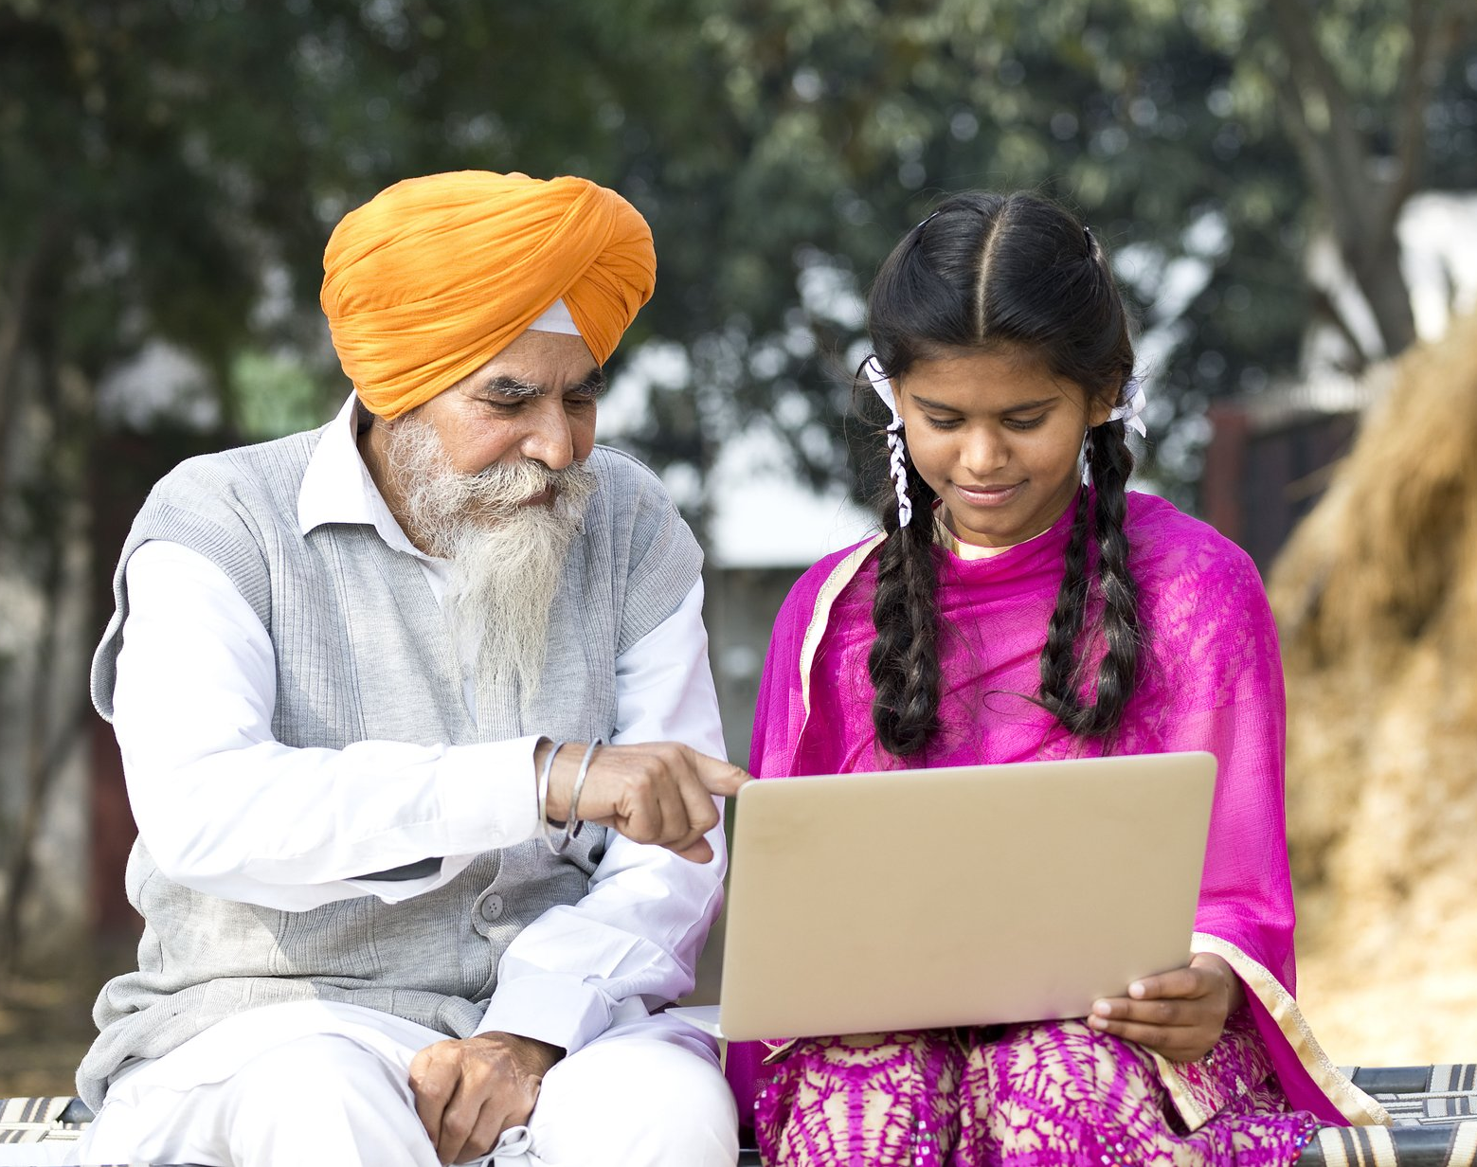
Tools and Resources to Support Equitable Partnerships

Slide 4
Tools and Resources: General
8 Principles for Gender Equality and Social Inclusion, FHI 360
Gender Marker Toolkit, CARE
Equality Accelerator and Gender Transformative Marker, Plan International
LGBTQI+ Integration Resources, USAID
New Partnership Initiative, Locally Led Development Tools and Localization Tool Webinar, USAID
M&E Strategies for Disability Inclusion in International Development, Chemonics
Deep Listening Approaches for Partnerships, CDA Collaborative
Gender Advocates Data Hub, Equal Measures 2030
Data 2X
Tips for budgeting for reasonable accommodations, MIUSA
Global Center for Gender Equality, Stanford Medicine

Slide 5
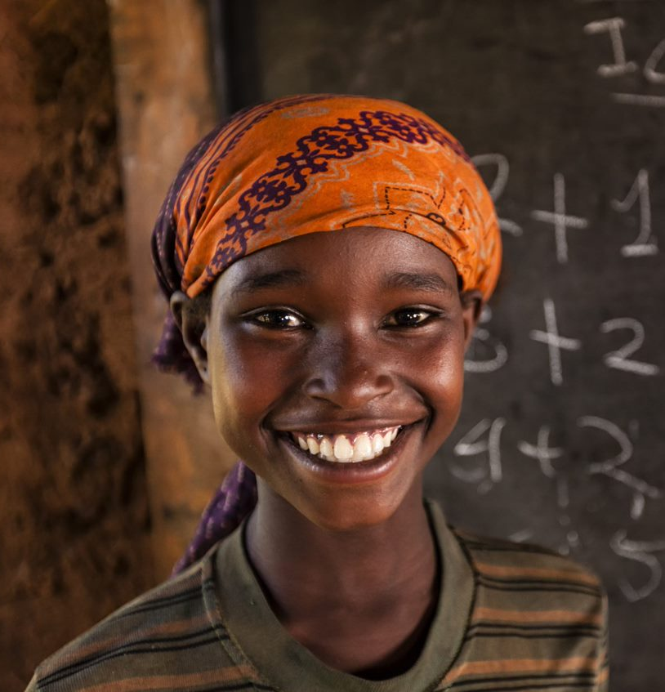
Track 1 Tools and Resources: Equitable Partnerships for Economic Empowerment
Toolkit to Address GBV in Agriculture and Market Systems Development, Feed the Future, Advancing Women’s Empowerment, USAID
How the Private Sector Measures Social Inclusion and its Return on Investment: A Framework to Inform Future Research, MarketShare Associates
Global Gender Gap Report, 2022, World Economic Forum
Women, Business and the Law, 2022, The World Bank
USAID Women’s Economic Empowerment Community of Practice, Banyan Global
Publications, Self-Employed Women’s Association of India

Slide 6
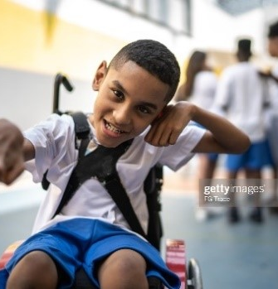
Track 2 Tools and Resources: Equitable Partnerships for Inclusive Education
Solidarity Circle: A Feminist Facilitator's Guide to Creating a Safe Space for Young People, UNGEI
Integrating LGBTQI+ Considerations into Education Programming, USAID
LGBTQI Inclusive Education Report, Index and Map, IGLYO
Inclusive Education online learning module, USAID
A whole school approach to prevent school related gender-based violence, UNGEI
Applying a Whole School Approach to prevent School-Related GBV: Lessons from Zimbabwe | UNGEI, UNGEI

Slide 7
Track 3 Tools and Resources: Equitable Partnerships for Transformative Health
From Shadows to Centre, Rising Flame, India
Neglected and Forgotten Women with Disabilities During COVID Crisis in India, Rising Flame and SightSavers
Publications on Women’s Health, Center for Women’s Health and Information
Strengthening and Localising Women’s Leadership and Disability Inclusion in Humanitarian Action, Shifting the Power Coalition
New Approach Helps Nursing and Midwifery Schools in Mali Improve Curricula and Achieve Accreditation, IntraHealth

Slide 8
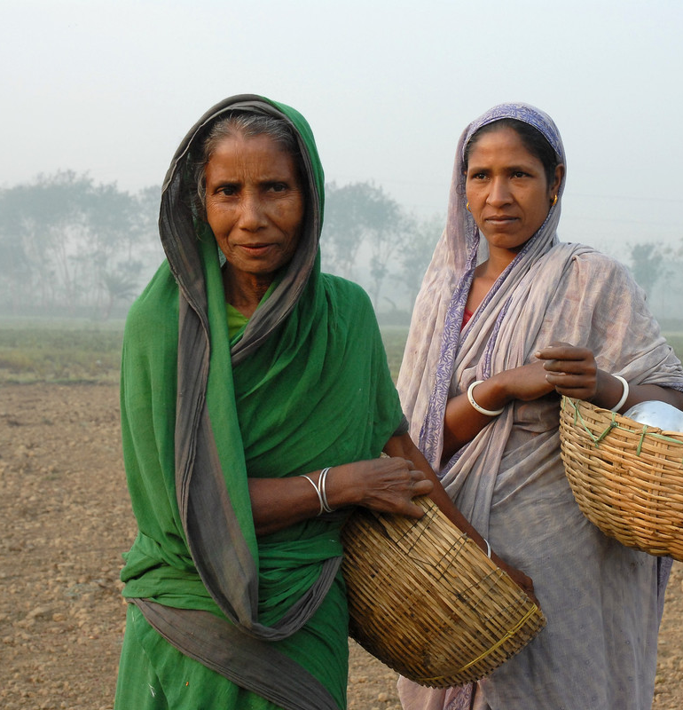
Track 4 Tools and Resources: Equitable Partnerships for Climate Change and Environment
The Listening Project, CDA Collaborative
Publications and Studies, GRAVIS, India
Deaf to the Marrow: Deaf Social Organizing and Active Citizenship in Việt Nam, Audrey Cooper, Gallaudet University
Citizenship, Politics, Difference: Perspectives from Sub-Saharan Signed Language Communities, Audrey Cooper and Khadijat Rashid
Pacific Case Study, Shifting the Power Coalition

Slide 9
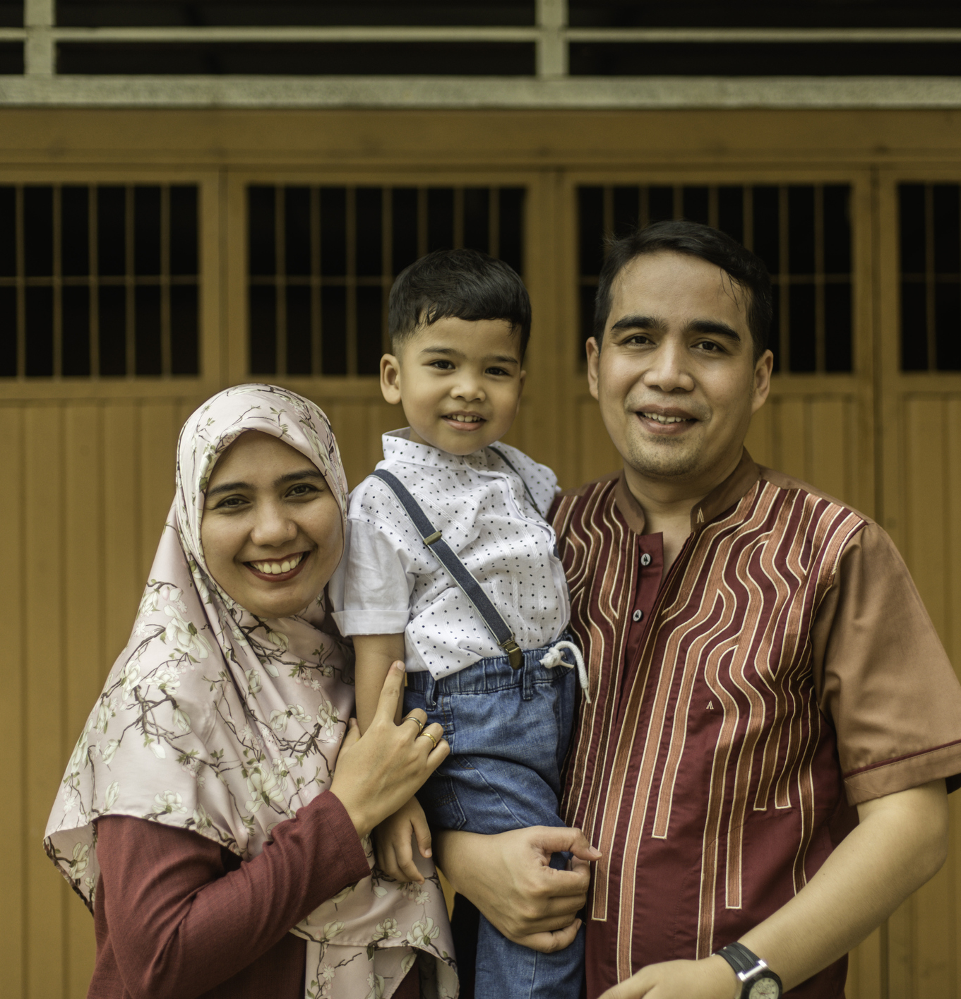
Track 5 Tools and Resources: Equitable Partnerships for Gender-based Violence
Toolkit to Address Gender-Based Violence in Agriculture and Market Systems Development, Feed the Future Advancing Women’s Empowerment Program, USAID
Women’s Human Rights, Traditional Cultural Beliefs and Tenets in Nigeria, Center for Women’s Health and Information
Elimination Of Violence Against Women and Girls – The Role Of Religious Leaders, Center for Women’s Health & Information
A whole school approach to prevent school related gender-based violence | UNGEI, UNGEI
Publications, Nana Women’s and Girls Empowerment, Nigeria

Slide 10
Recommendations to Support Equitable Partnerships

Slide 11
General Recommendations for Equitable Partnerships
Establish quotas and targets for having diverse, gender-balanced and historically-excluded groups of people in decision-making roles within partner consortiums, such as disabled women, transgender individuals, gender-based violence (GBV) survivors, etc.
Provide active, in-person listening sessions; assistive technology; reasonable accommodations; local language interpretation; and increased time, access, flexibility and security for co-creation processes.
Use feminist funding models and flexible financing to support the empowerment of traditional and indigenous communities. Prioritize more horizontal partnership models that provide support when and where communities most need it.
Invest in stronger public-private-civil society partnerships. Harmonize equity policies and approaches at the beginning and use common gender and social inclusion markers.

Slide 12
General Recommendations for Equitable Partnerships (cont’d)
Budget for reasonable accommodations for co-design, implementation and monitoring, evaluation and learning (MEL).
Involve diverse program participants in co-design through local partner-led community meetings, focus group discussions and workshops.
Perform rapid gender and social inclusion (GESI) analyses at initial co-design stage of consortium and project formation. Then work jointly with diverse partners after project start-up to guarantee comprehensive, intersectional GESI analyses within first 6 months.
Work with local partners — including indigenous groups — on locally led impact story telling, ensuring accessibility through local language and sign language interpretation. Ensure vigorous international and locally validated research ethics and protocol.
Engage religious institutions and leaders as consortium partners and advisors.

Slide 13
General Recommendations for Equitable Partnerships (cont’d)
Work with local partners to rethink monitoring, evaluation and learning systems.
Identify alternative or proxy indicators and disaggregate by sex, age and disability.
Increase flexibility, access and innovation on reporting mechanisms and deadlines.
Invest in impact evaluations that include locally led and indigenous story telling. Ensure vigorous international and locally validated research ethics and protocol.
Create implementation and learning mechanisms within donor contracts to increase flexibility, local ownership, and joint decision-making and reporting.
Engage religious institutions and leaders as consortium partners and advisors.

Slide 14
Track 1 Recommendations: Equitable Partnerships for Economic Empowerment
Ensure women entrepreneurs, women’s business associations and women’s chambers of commerce are at design and co-creation tables. Integrate flexible funding, start-up capital and coaching.
Create implementation and learning mechanisms within donor and partner contracts to increase flexibility, local ownership, and joint decision-making and reporting.
Engage local, provincial and national government officials, including Ministries that address social affairs, women’s affairs, gender, disability and youth — in economic empowerment programs.
Prioritize GESI integrated social and behavior change (SBC) models and partner expertise in economic empowerment project co-design.

Slide 15
Track 1 Recommendations (cont’d): Equitable Partnerships for Economic Empowerment
Address digital divides for older women within economic empowerment consortium planning. Support intergenerational training and coaching, and improved technology access during co-creation, implementation and evaluation processes.
Support sufficient time for consortium development and co-design to ensure that business associations and private sector entities fully understand and have integrated “Do No Harm,” anti-harassment and GBV mitigation policies; strategies; and accountability.
Use common GESI marker tool at the beginning of economic empowerment programs to harmonize policies, approaches and measurement tools.
Prioritize talent pipelines for future economies (agriculture, technology, health systems, green jobs) and make incentives for private sector to hire historically excluded groups.

Slide 16
Track 2 Recommendations: Equitable Partnerships for Inclusive Education
Follow decolonization principles. Trust and facilitate deeper and wider listening sessions and inclusive education co-design with communities, local education NGOs and youth groups.
Remember the important role of older people in education programs. Take intergenerational approaches to enabling social and behavior change.
Prioritize creating safe spaces and leadership roles for transgender and gender non-diverse youth in inclusive education consortiums.
Consider UNGEI’s model of Solidarity Circles to support more diverse, accessible collaboration spaces, both formal and informal.
Ensure that national professional associations, organizations of people with disabilities, women, LGBTQI+, and various Ministries (higher education and health) are engaged in locally led accreditation systems and structures for professional education.

Slide 17
Track 3 Recommendations: Equitable Partnerships for Transformative Health
Ensure LGBTQIA+ organizations are represented within health partner consortiums. Perform rapid GESI analyses before co-design to identify related risks and coordinate safe co-design mechanisms.
Partner with NGO’s, CSO’s and health care businesses on the provision of safe home and psychosocial facilities for survivors in need of mental health services.
Engage religious institutions (e.g., churches, mosques, temples, etc.) in sexual and reproductive health (SRH) projects in mutually beneficial ways and with the help of religious and traditional leader champions.

Slide 18
Track 3 Recommendations (cont’d): Equitable Partnerships for Transformative Health
Increase partnerships with organizations of people with disabilities (OPDs). Work with them to guarantee reasonable accommodations in health care programs and facilities for people with disabilities (e.g., sign language interpretation, assistive technologies). Ensure healthcare providers’ info is in accessible formats for those with physical, sensory and intellectual disabilities, as well as those with low literacy.
Engage partners that can help build the capacity of health workers on GBV and psychosocial or psychological first aid (PFA), especially frontline health facility staff and medical practitioners.
Ensure harmonization of gender equality and social inclusion approaches and policies in health programs with public/private/civil society partnerships.

Slide 19
Track 4 Recommendations: Equitable Partnerships for Climate Change and Environment
Reform climate disaster responses by including leadership from diverse community members with lived realities (i.e., women and girls, younger, older, LGBTQIA+, indigenous, people living with disabilities, etc.) Dedicate corresponding consortium partner resources to ensure more accessible technology and information sharing during rapid co-creation and co-evaluation processes.
Better engage organizations of people with different disabilities as full consortium partners in climate change mitigation initiatives. Budget for reasonable accommodations in all activities to better support grantees and participants, including D/deaf and hard of hearing community members.
Prioritize collaboratively created community charters for natural resource management (NRM) committees and project design, budget monitoring and evaluation, and greater leadership of historically excluded groups.

Slide 20
Track 4 Recommendations (cont’d): Equitable Partnerships for Climate Change and Environment
Engage private sector companies that are committed to hiring urban and rural women for green jobs. Work with lead firms as consortium partners to help identify incentives for potential green employers. Engage financial sector partners committed to helping advance women-owned green businesses with flexible and low-rate loans.
Support donor-funded resilience funds during crises to enable more women, LGBTQIA+ and disability groups to help design and lead interventions. Budget for reasonable accommodations even in emergency settings.
Support greater and more inclusive localization efforts in climate change and NRM projects by devoting higher budgets and consortium leadership roles to historically excluded organizations and businesses.
Ensure that diverse groups of women and girls have decision-making power and access in all climate action and disaster risk reduction programs. This must include local language interpretation, visualization and oral sharing of data for those with low or no literacy, and sign language interpretation. Sign language access is non-negotiable, as it is deaf women’s call to action to be able to empower their communities.

Slide 21
Track 5 Recommendations: Gender-based Violence
Partner with different local organizations in GBV programs that can effectively
Use survivor-centered HRB approaches and deep, ongoing listening sessions
Engage older women in co-design mechanisms as cultural gatekeepers
Address unique strengths and needs of women/gender diverse with disabilities
Support youth leaders and positive youth development approaches
Navigate empowered, yet safe approaches to LGBTQI+ inclusion
Enable male champions, synchronized methods and family system approaches
Co-perform more extensive community needs and assets assessments and community dialogues for design (w traditional/religious leaders, schools, market actors, employers, police, judiciaries, social workers, healthcare systems, families.)
While broadening partnerships, be aware of the disproportionate power that certain stakeholders have in muffling survivor voices (e.g., traditional/religious leaders, police, judges, husbands, fathers, government officials, politicians, employers).

Slide 22
Track 5 Recommendations (cont’d): Gender-based Violence
Provide safe spaces for GBV survivors to discuss the challenges they face, as well as barriers to care and solutions that work for them.
Coordinate and create clear communication channels with GBV-focused groups.
Engage economic partners and the private sector in integrated GBV mitigation strategies to create alternative solutions (to child marriage, for example) and empowerment solutions.
Ensure funding for GBV interventions is long-term in order to make lasting change. Short-term GBV funding can be counterproductive and sometimes even harmful.
Rethink M&E and participant feedback mechanisms that are less accessible or personal (e.g., suggestion boxes). Support one-on-one and focus group discussions.
Embrace growth feedback, despite donor pressure to show immediate, positive impact.
Engage local partners in more comprehensive evaluations at mid and endpoints with strong community input, accessible/visual data sharing back to community, two-way communication mechanisms for closeout, and locally led next steps.

Slide 23
Day 1 & 2 Agenda Day 3 Agenda Day 1, 2 & 3 Video Recordings & PowerPoints CEO Roundtable Recording: DEIA, Power & Partnerships

Slide 24
Organizational Web Sites of Summit Speakers
Abt Associates
ACDI/VOCA
Achieving Health Nigeria Initiative
Aisha Association for Woman and Child Protection
American Bar Association Rule of Law Initiative
Asociación de Mujeres Madre Tierra
Banco Popular Colombia
Banyan Global
CARE International
CareerMe
Casuga Integrated Farm School
Center for International Private Enterprise
Chemonics International
EnCompass LLC
FHI 360
Foodpanda
Gallaudet University
Global Communities
Grameen Foundation
GRAVIS
GreeneWorks
Health Keepers Network
Helem, LGBTQIA+ Rights Organization
HelpAge International

Slide 25
Organizational Web Sites of Summit Speakers
ICRW Asia
Indigenous Peoples Alliance for Rights & Development (IPARD)
Institute for Family Health, King Hussein Foundation
International Executive Service Corps (IESC)
JHPIEGO
Kenya Wildlife Conservancies Association
MarketShare Associates
MenEngage Alliance
Mental Health Society of Ghana
Mercy Corps
Moises Bertoni Foundation
Mon Bamboo Company
Nana Women and Girls Empowerment Initiative
Network of Women with Disabilities
Pacific Rainbows Advocacy Network
PepsiCo
Plan International
Plataforma 25 de Noviembre
Project Concern India (PCI)
Psycho-Education and Applied Research Center for the Deaf (PARD)
Q-Initiative
Raising Voices

Slide 26
Organizational Web Sites of Summit Speakers
Rising Flame
Root of Generations
Rwanda Union of the Blind
Save the Children
Shifting the Power Coalition
SightSavers
Sonke Gender Justice
The Asia Foundation
UNGEI
University of Global Health Equity
USAID
Voice of Disability Initiative
Women Against Rape
Women for Women International
Women in Need (WIN)
Women with Disabilities Development Foundation

Slide 27
We want to thank our amazing partners and sponsors!

Slide 30
We welcome your questions and comments. Please contact:
GESSI@fhi360.org

